Slide 1
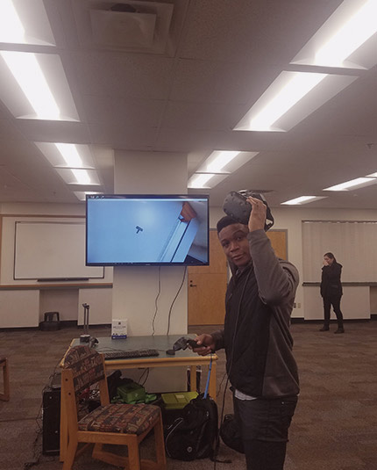
Chicken Galaga
BY: EVERISTUS AKPABIO

Slide 2
Game Summary
v
Player is presented a start screen and clicks on the START button to begin the game
Player uses the arrow buttons to navigate the game with a spaceship
Player uses the SPACE bar to shoot bullets vertically at enemies
Birds appear in waves as enemies
Asteroids appear in waves as enemies
Player loses a life when hit by a bird, an asteroid or their droppings
Large Asteroids split in to smaller ones when shot and the smaller ones are destroyed when shot
Player earns a few points for hitting an enemy and more for destroying them
Player respawns with protection around their spaceship so they have time to recoup and continue the wave
If the player’s health is depleted or all the waves are completed, the game ends.

Slide 3
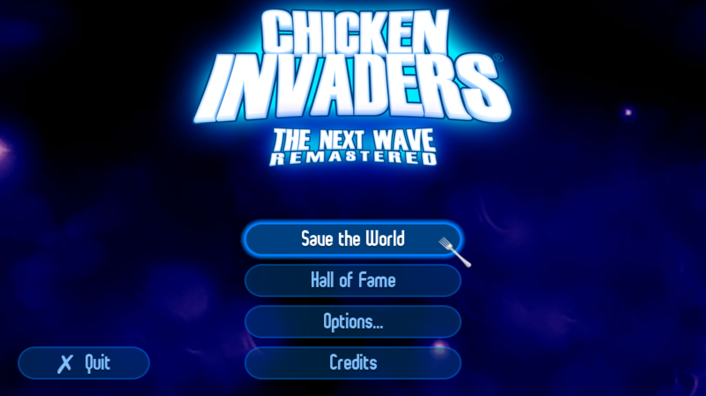
<As a> gamer, <I want to> press START button <so that> I can start playing game
v

Slide 4
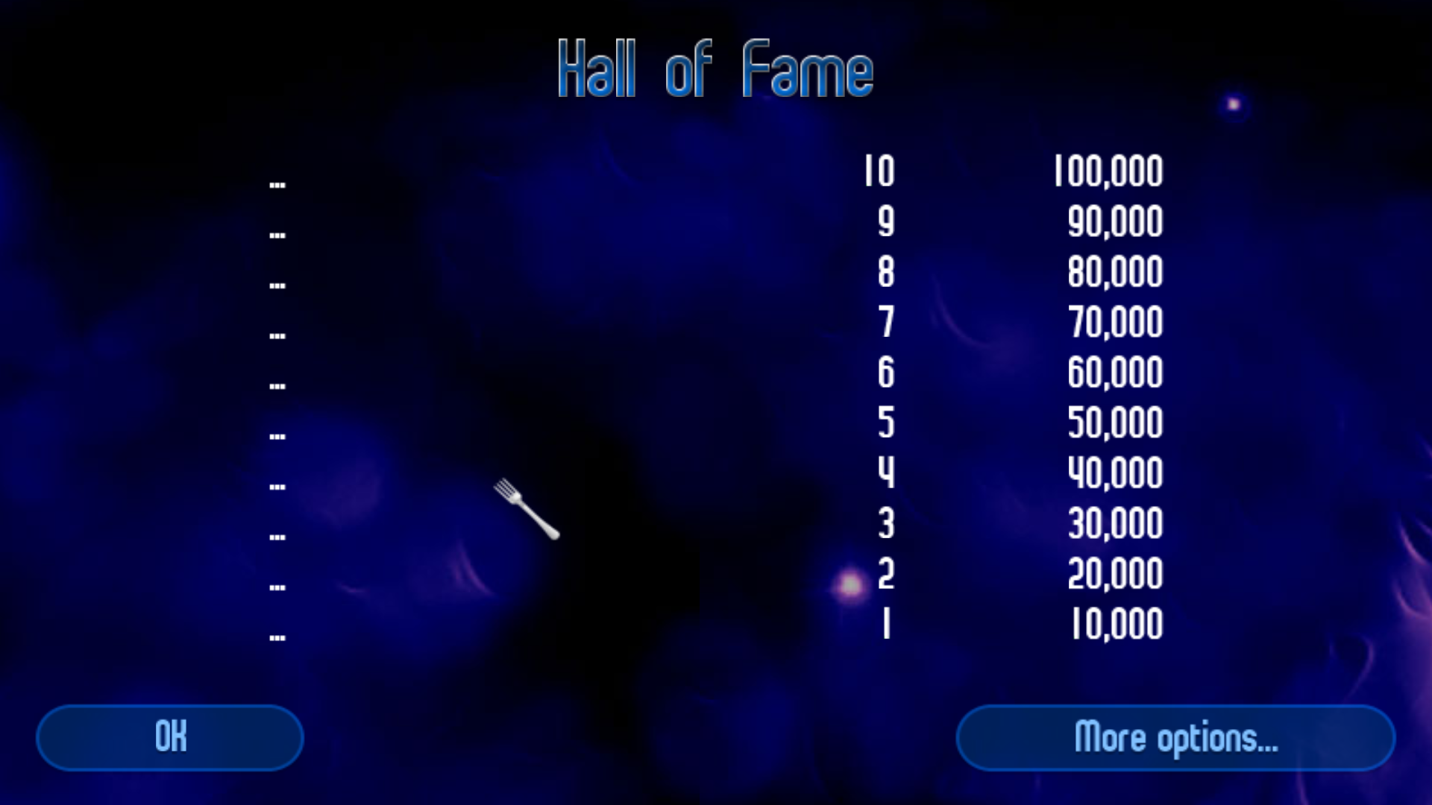
<As a> gamer, <I want to> look at the leaderboard <so that> I can see how my scores stack up
v

Slide 5
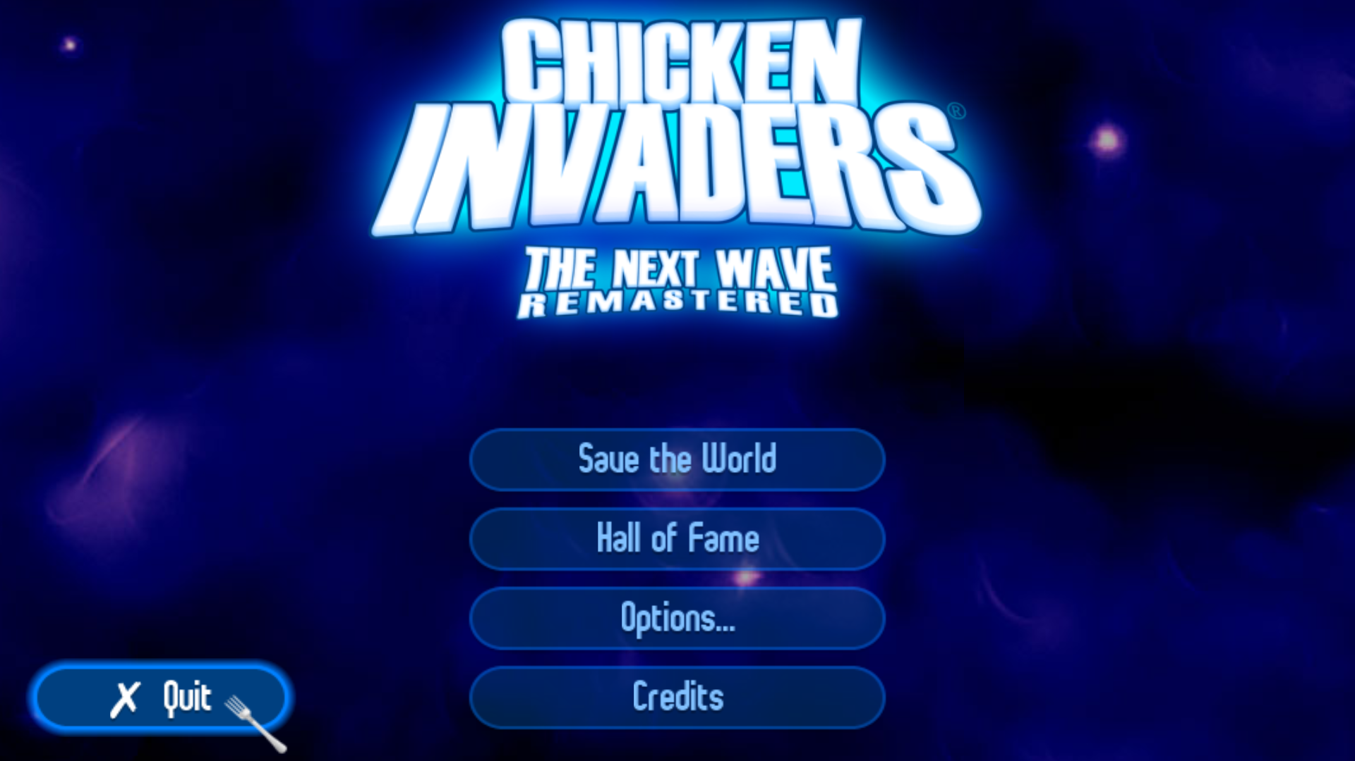
<As a> gamer, <I want to> click on the QUIT button <so that> I can exit the game
v

Slide 6
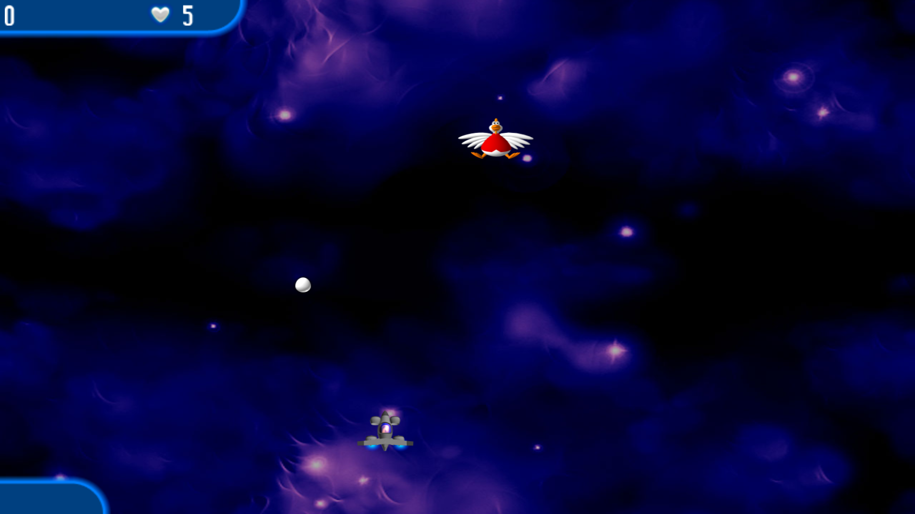
<As a> gamer, <I want to> move the spaceship using four arrow keys <so that> I can navigate the game scene
v

Slide 7
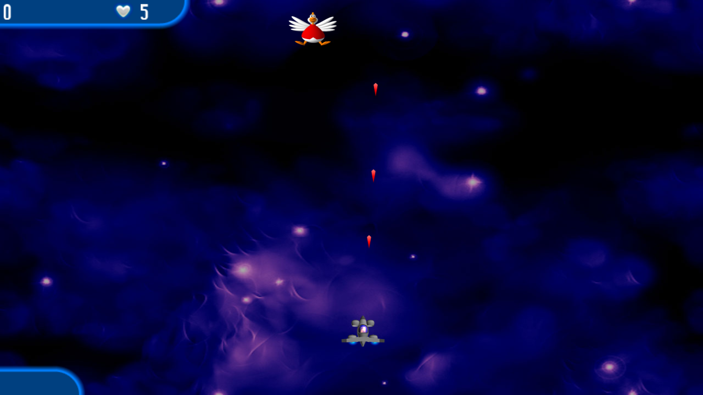
<As a> gamer, <I want to> shoot bullets when I press the SPACE bar <so that> I can kill enemies
v

Slide 8
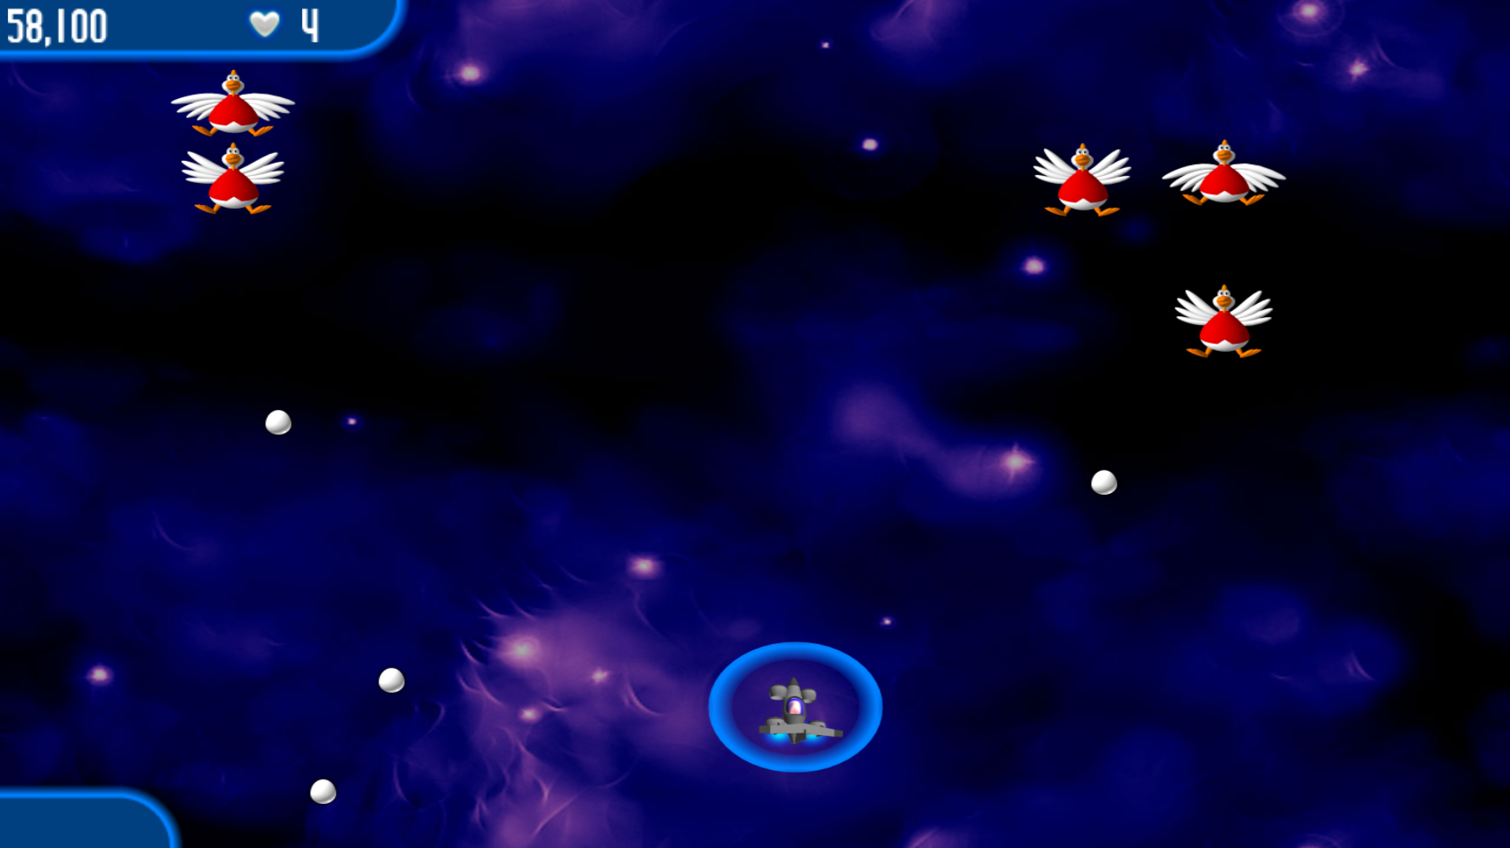
<As a> gamer, <I want to> earn points for killing enemies <so that> I can increase my score
v

Slide 9
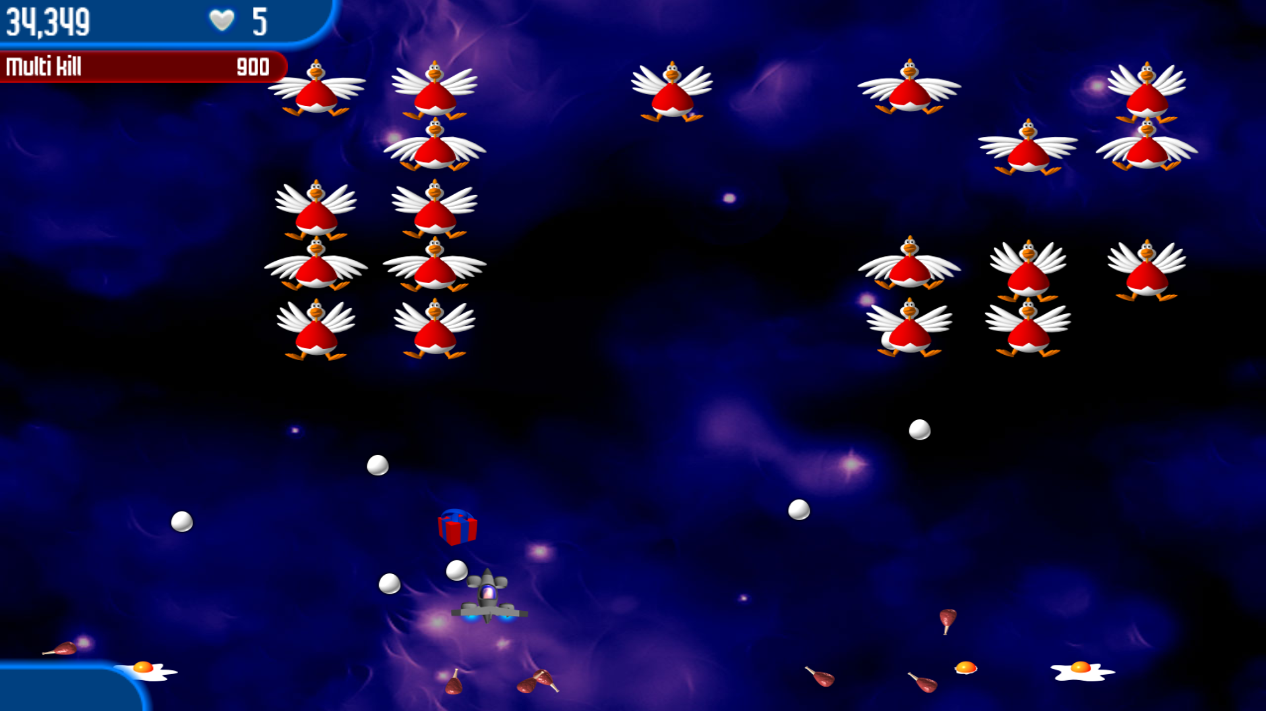
<As a> gamer, <I want to> collect powerups from the scene <so that> I can have an advantage against enemies
v

Slide 10
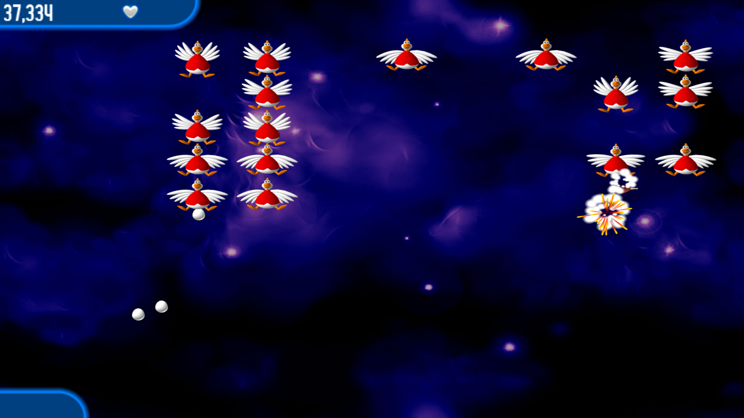
<As a> gamer, <I want to> be susceptible to damage <so that> I can lose a life when hit by the enemy or their droppings
v

Slide 11
<As a> gamer, <I want to> have protection when I respawn <so that> I can have time to re-coup and continue the wave
v

Slide 12
<As a> gamer, <I want to> have a health bar <so that> I can lose when it is depleted
v

Slide 13
<As a> bullet, <I want to> travel from the shooter's barrel vertically <so that> I can kill enemies as I hit them while on the move
v

Slide 14
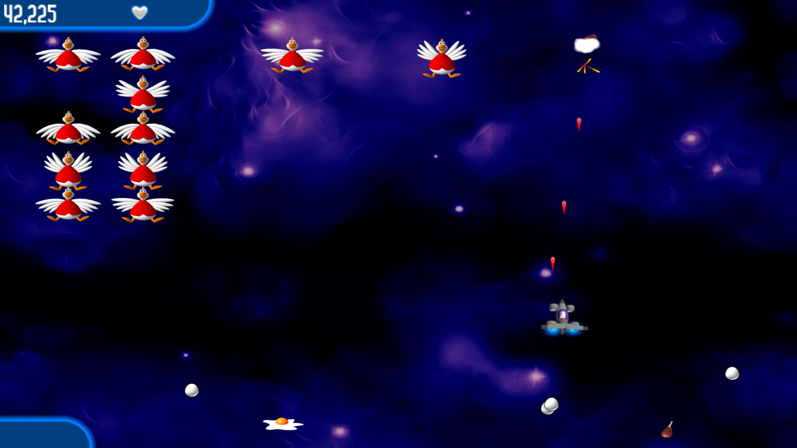
<As a> bullet, <I want to> explode on impact <so that> I can deal damage to enemies.
v

Slide 15
<As a> Bird, <I want to> appear during a wave and take formation <so that> I can make it harder for a player to get past me
v

Slide 16
<As a> Bird, <I want to> move randomly <so that> the gamer cannot easily kill me
v

Slide 17
<As a> Bird, <I want to> release lethal droppings <so that> I can damage the gamer's spaceship
v

Slide 18
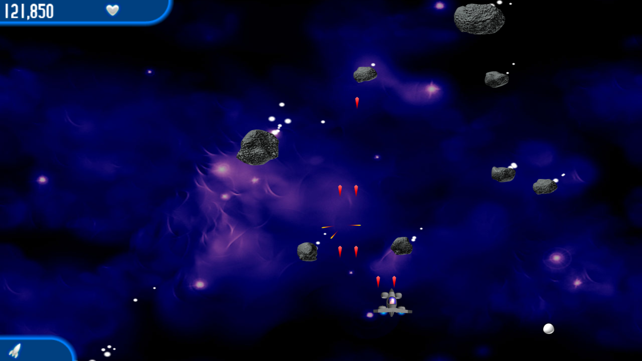
<As an> Asteroid, <I want to> appear during a wave and bounce around the screen <so that> it is harder for a player to predict my movement
v

Slide 19
<As an> Asteroid, <I want to> move randomly and be harder to destroy <so that> the gamer cannot easily kill me
v

Slide 20
<As an> Asteroid, <I want to> spawn more asteroids when I am destroyed <so that> I can make the wave harder for the player
v

Slide 21
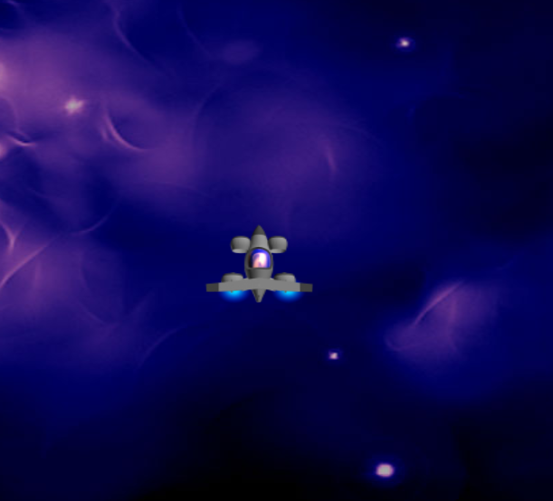
Thank You.
Game image credits to Chicken Invaders 2 by InterAction studios

